Slide 1
Agile Foundations with Scrum
Session 8: Scrum Culture and Values

Slide 2
Scrum Theory (3 Pillars of Scrum)
Transparency
Visibility – processes are visible to those responsible for the outcome.
Clarity – we are using the same words to describe things.
Definition of Done.
Inspection
Scrum artifacts and metrics (velocity, burndowns, backlogs, roll rates, retrospective data).
Adaption
Every scrum ceremony provides an opportunity to correct or improve.s

Slide 3
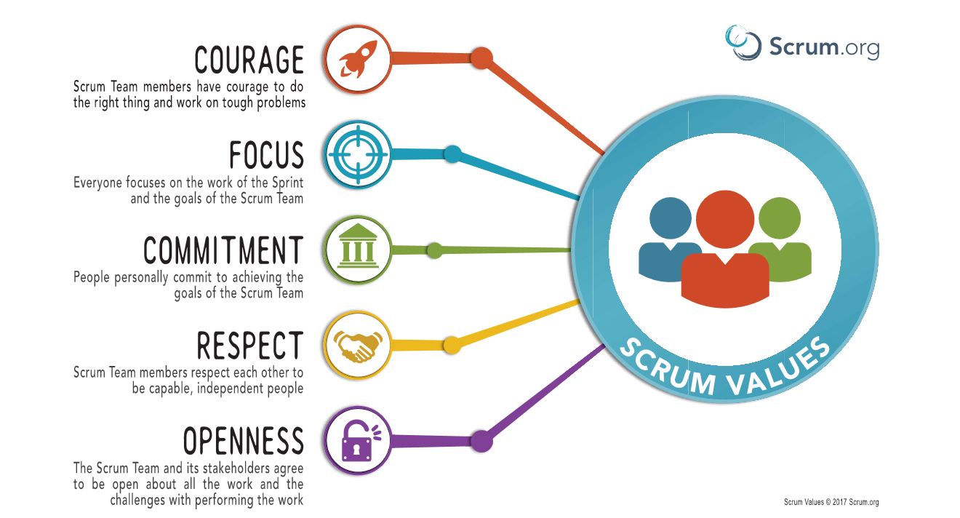
Scrum Values

Slide 4
Scrum Values
Courage – do the right thing and work through problems.
Focus – everyone focuses on the work of the Sprint and team goals.
Commitment – people commit to achieving goals.
Respect - team members respect each other to be capable, independent people.
Openness – team and stakeholders are open about all the work and the challenges of performing that work.
Notes:
The product owner can guess that a story is right sized, but only the team can accept a story into sprint planning.
The confirmation of size is a guess.
Sometimes the confirmation of size requires a research task, those tasks should be scheduled into the sprint work of the team (if the team is doing the research). Otherwise the responsibility for the research should follow a common sense model. The team members who can make the most sense out of the resulting information should be accountable for the research.

Slide 5
XP Values
Simplicity (Focus): We will do what is needed and asked for, but no more. This will maximize the value created for the investment made to date. We will take small simple steps to our goal and mitigate failures as they happen. We will create something we are proud of and maintain it long term for reasonable costs.
Communication (Openness): Everyone is part of the team and we communicate face to face daily. We will work together on everything from requirements to code. We will create the best solution to our problem that we can together.
Feedback (Inspect and Adapt/Commitment): We will take every iteration commitment seriously by delivering working software. We demonstrate our software early and often then listen carefully and make any changes needed. We will talk about the project and adapt our process to it, not the other way around.
Respect: Everyone gives and feels the respect they deserve as a valued team member. Everyone contributes value even if it's simply enthusiasm. Developers respect the expertise of the customers and vice versa. Management respects our right to accept responsibility and receive authority over our own work.
Courage: We will tell the truth about progress and estimates. We don't document excuses for failure because we plan to succeed. We don't fear anything because no one ever works alone. We will adapt to changes when ever they happen.

Slide 6
Learning from Scrum
Make inspection and adaption part of every part of the process.
Base decisions on data.
Schedule adaption tasks along with project work.
Think critically and be goal oriented.

Slide 7
Sources
Sutherland, Jeff., Schwaber, Ken. (November 2017). The Scrum Guide. Retrieved from http://www.scrumguides.org/docs/scrumguide/v2017/2017-Scrum-Guide-US.pdf#zoom=100
Verwijs, Christiaan. (n.d.) Scrum implementations fail when they ignore organizational culture. Agilistic Blog. Retrieved from https://blog.agilistic.nl/scrum-implementations-fail-when-they-ignore-organizational-culture/
Wells, Don. (2009). Values of Extreme Values. Retrieved from http://www.extremeprogramming.org/values.html

